Slide 1
Security at network layer level
IPSec

Slide 2
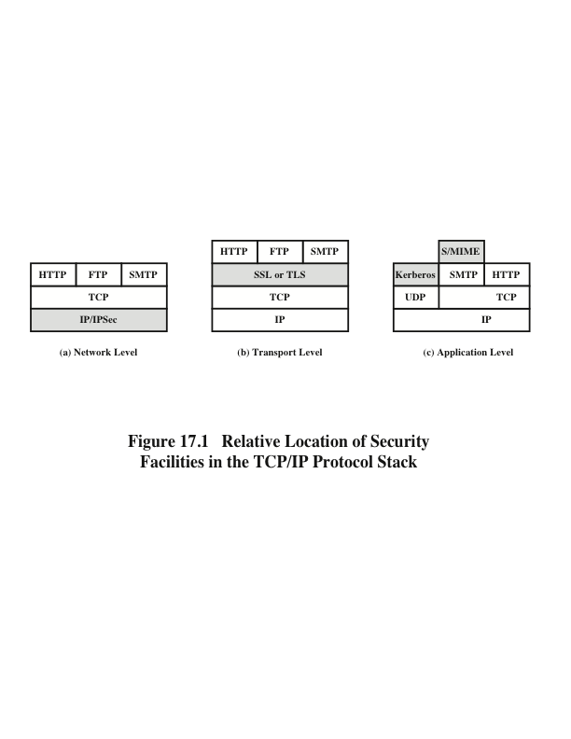
Notes:
A number of approaches to providing Web security are possible. The various approaches
that have been considered are similar in the services they provide and, to
some extent, in the mechanisms that they use, but they differ with respect to their
scope of applicability and their relative location within the TCP/IP protocol stack.
Figure 17.1 illustrates this difference. One way to provide Web security is
to use IP security (IPsec) (Figure 17.1a). The advantage of using IPsec is that it is
transparent to end users and applications and provides a general-purpose solution.
Furthermore, IPsec includes a filtering capability so that only selected traffic need
incur the overhead of IPsec processing.
Another relatively general-purpose solution is to implement security just
above TCP (Figure 17.1b). The foremost example of this approach is the Secure
Sockets Layer (SSL) and the follow-on Internet standard known as Transport
Layer Security (TLS). At this level, there are two implementation choices. For full
generality, SSL (or TLS) could be provided as part of the underlying protocol suite
and therefore be transparent to applications. Alternatively, SSL can be embedded
in specific packages. For example, Netscape and Microsoft Explorer browsers come
equipped with SSL, and most Web servers have implemented the protocol.
Application-specific security services are embedded within the particular
application. Figure 17.1c shows examples of this architecture. The advantage of this
approach is that the service can be tailored to the specific needs of a given application.

Slide 3
Network Layer: IP Security Overview
RFC 1636: “Security in the Internet Architecture”
Issued in 1994 by the Internet Architecture Board (IAB)
Identifies key areas for security mechanisms
Need to secure the network infrastructure from unauthorized monitoring and control of network traffic
Need to secure end-user-to-end-user traffic using authentication and encryption mechanisms
IAB included authentication and encryption as necessary security features in next generation IP (IPv6)
The IPsec specification now exists as a set of Internet standards
Notes:
In 1994, the Internet Architecture Board (IAB) issued a report titled “Security in
the Internet Architecture” (RFC 1636). The report identified key areas for security
mechanisms. Among these were the need to secure the network infrastructure from
unauthorized monitoring and control of network traffic and the need to secure end-user-
to-end-user traffic using authentication and encryption mechanisms.
To provide security, the IAB included authentication and encryption as necessary
security features in the next-generation IP, which has been issued as IPv6.
Fortunately, these security capabilities were designed to be usable both with the
current IPv4 and the future IPv6. This means that vendors can begin offering these
features now, and many vendors now do have some IPsec capability in their products.
The IPsec specification now exists as a set of Internet standards.

Slide 4
Applications of IPsec
Provides capability to secure communications across a LAN, private and public WANs, and the Internet
Examples include:
Secure branch office connectivity over the Internet
Secure remote access over the Internet
Establishing extranet and intranet connectivity with partners
Enhancing electronic commerce security
Principal feature of IPsec: can encrypt and/or authenticate all traffic at network (IP) level
So all distributed applications (remote logon, client/server, e-mail, file transfer, Web access) can be secured
Notes:
IPsec provides the capability to secure communications across a LAN, across private
and public WANs, and across the Internet. Examples of its use include:
• Secure branch office connectivity over the Internet: A company can build a
secure virtual private network over the Internet or over a public WAN. This
enables a business to rely heavily on the Internet and reduce its need for private
networks, saving costs and network management overhead.
• Secure remote access over the Internet: An end user whose system is equipped
with IP security protocols can make a local call to an Internet Service Provider
(ISP) and gain secure access to a company network. This reduces the cost of
toll charges for traveling employees and telecommuters.
• Establishing extranet and intranet connectivity with partners: IPsec can be
used to secure communication with other organizations, ensuring authentication
and confidentiality and providing a key exchange mechanism.
• Enhancing electronic commerce security: Even though some Web and electronic
commerce applications have built-in security protocols, the use of IPsec
enhances that security. IPsec guarantees that all traffic designated by the network
administrator is both encrypted and authenticated, adding an additional
layer of security to whatever is provided at the application layer.
The principal feature of IPsec that enables it to support these varied applications
is that it can encrypt and/or authenticate all traffic at the IP level. Thus, all
distributed applications (including remote logon, client/server, e-mail, file transfer,
Web access, and so on) can be secured.

Slide 5
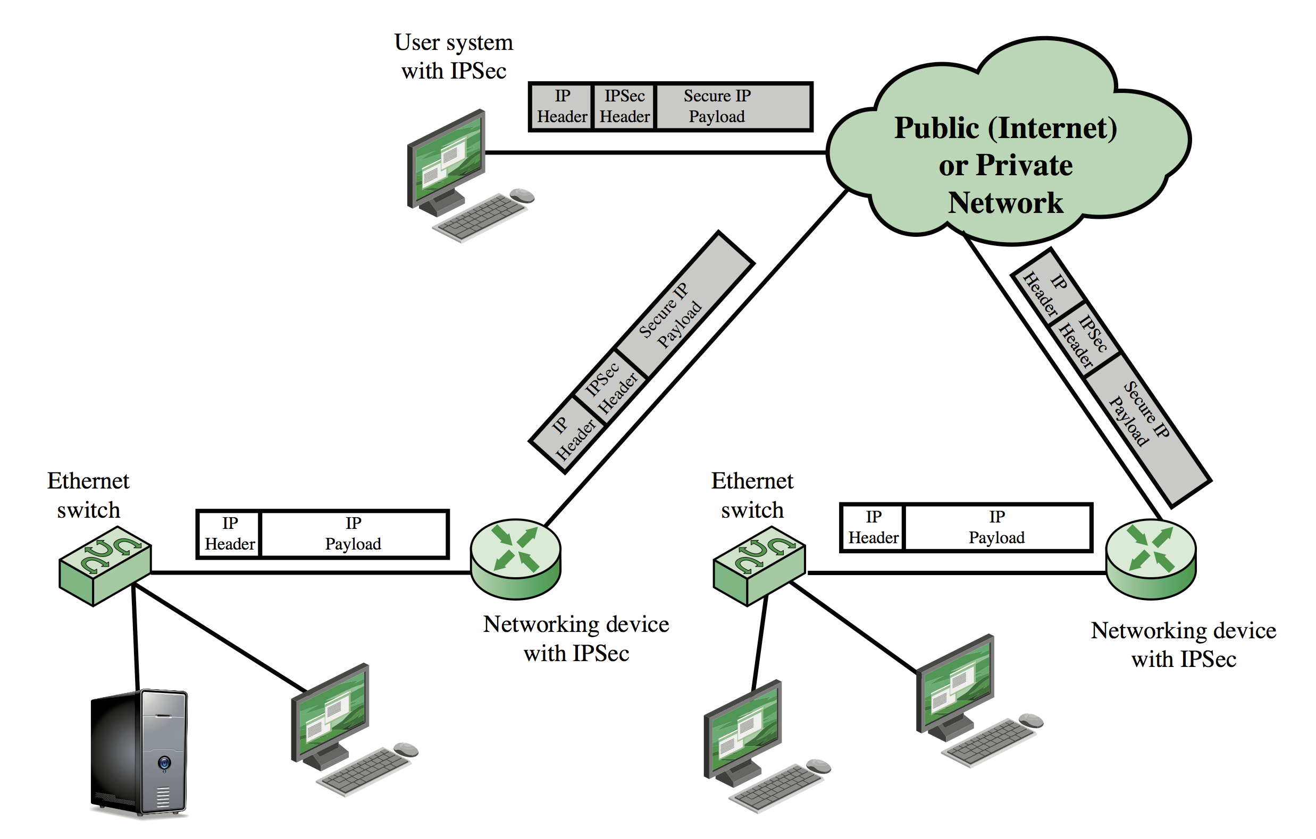
IP Security Scenario
Notes:
Figure 9.1 is a typical scenario of IPsec usage. An organization maintains
LANs at dispersed locations. Nonsecure IP traffic is conducted on each LAN. For
traffic offsite, through some sort of private or public WAN, IPsec protocols are used.
These protocols operate in networking devices, such as a router or firewall, that
connect each LAN to the outside world. The IPsec networking device will typically
encrypt and compress all traffic going into the WAN and decrypt and decompress
traffic coming from the WAN; these operations are transparent to workstations and
servers on the LAN. Secure transmission is also possible with individual users who
dial into the WAN. Such user workstations must implement the IPsec protocols to
provide security.

Slide 6
Benefits of IPSec
When IPsec is implemented in firewall or router, it provides strong security applicable to all traffic crossing the perimeter
Traffic within company/workgroup has no overhead from security-related processing
IPsec in firewall resists bypass if all outside traffic must use IP and the firewall is the only way Internet traffic enters organization
IPsec below the transport layer (TCP, UDP); transparent to applications
No need to change software on a user or server system when IPsec is implemented in the firewall or router
IPsec can be transparent to end users
No need to train users on security mechanisms, issue keys on a per-user basis, or revoke keys when users leave organization
IPsec can provide security for individual users if needed
Useful for offsite workers, setting up secure virtual subnetwork within an organization for sensitive applications
Notes:
Some of the benefits of IPsec:
• When IPsec is implemented in a firewall or router, it provides strong security
that can be applied to all traffic crossing the perimeter. Traffic within
a company or workgroup does not incur the overhead of security-related
processing.
• IPsec in a firewall is resistant to bypass if all traffic from the outside must use
IP and the firewall is the only means of entrance from the Internet into the
organization.
• IPsec is below the transport layer (TCP, UDP) and so is transparent to applications.
There is no need to change software on a user or server system when
IPsec is implemented in the firewall or router. Even if IPsec is implemented in
end systems, upper-layer software, including applications, is not affected.
• IPsec can be transparent to end users. There is no need to train users on security
mechanisms, issue keying material on a per-user basis, or revoke keying
material when users leave the organization.
• IPsec can provide security for individual users if needed. This is useful for offsite
workers and for setting up a secure virtual subnetwork within an organization
for sensitive applications.

Slide 7
IPsec Documents
Covers the general concepts, security requirements, definitions, and mechanisms defining IPsec technology
Current specification is RFC 4301, Security Architecture for the Internet Protocol
Authentication Header (AH)
An extension header to provide message authentication
The current specification is RFC 4302, IP Authentication Header
Encapsulating Security Payload (ESP)
Consists of an encapsulating header and trailer used to provide encryption or combined encryption/authentication
The current specification is RFC 4303, IP Encapsulating Security Payload (ESP)
A collection of documents describing the key management schemes for use with IPsec
The main specification is RFC 5996, Internet Key Exchange (IKEv2) Protocol, but there are a number of related RFCs
Cryptographic algorithms
This category encompasses a large set of documents that define and describe cryptographic algorithms for encryption, message authentication, pseudorandom functions (PRFs), and cryptographic key exchange
Other
There are a variety of other IPsec-related RFCs, including those dealing with security policy and management information base (MIB) content
Architecture
Internet Key Exchange (IKE)
Notes:
IPsec encompasses three functional areas: authentication, confidentiality, and key
management. The totality of the IPsec specification is scattered across dozens of
RFCs and draft IETF documents, making this the most complex and difficult to
grasp of all IETF specifications. The best way to grasp the scope of IPsec is to consult
the latest version of the IPsec document roadmap, which as of this writing is RFC
6071 [IP Security (IPsec) and Internet Key Exchange (IKE) Document Roadmap ,
February 2011]. The documents can be categorized into the following groups.
• Architecture: Covers the general concepts, security requirements, definitions,
and mechanisms defining IPsec technology. The current specification is RFC
4301, Security Architecture for the Internet Protocol .
• Authentication Header (AH): AH is an extension header to provide message
authentication. The current specification is RFC 4302, IP Authentication
Header . Because message authentication is provided by ESP, the use of AH
is deprecated. It is included in IPsecv3 for backward compatibility but should
not be used in new applications. We do not discuss AH in this chapter.
• Encapsulating Security Payload (ESP): ESP consists of an encapsulating
header and trailer used to provide encryption or combined encryption/authentication.
The current specification is RFC 4303, IP Encapsulating Security
Payload (ESP) .
• Internet Key Exchange (IKE): This is a collection of documents describing the
key management schemes for use with IPsec. The main specification is RFC
5996, Internet Key Exchange (IKEv2) Protocol , but there are a number of
related RFCs.
• Cryptographic algorithms: This category encompasses a large set of documents
that define and describe cryptographic algorithms for encryption, message authentication,
pseudorandom functions (PRFs), and cryptographic key exchange.
• Other: There are a variety of other IPsec-related RFCs, including those dealing
with security policy and management information base (MIB) content.

Slide 8
IPsec Services
IPsec provides network layer security services by enabling a system to:
Select required security protocols
Determine the algorithm(s) to use for the service(s)
Establish crypto keys required to provide requested services
RFC 4301 lists the following services:
Access control
Connectionless integrity
Data origin authentication
Reject replayed packets (form of partial sequence integrity)
Confidentiality (encryption)
Limited traffic flow confidentiality
Notes:
IPsec provides security services at the IP layer by enabling a system to select required
security protocols, determine the algorithm(s) to use for the service(s), and
put in place any cryptographic keys required to provide the requested services. Two
protocols are used to provide security: an authentication protocol designated by the
header of the protocol, Authentication Header (AH); and a combined encryption/
authentication protocol designated by the format of the packet for that protocol,
Encapsulating Security Payload (ESP). RFC 4301 lists the following services:
• Access control
• Connectionless integrity
• Data origin authentication
• Rejection of replayed packets (a form of partial sequence integrity)
• Confidentiality (encryption)
• Limited traffic flow confidentiality

Slide 9
Transport and Tunnel Modes
Transport Mode
Provides protection mostly for upper-layer protocols, e.g., TCP or UDP segment, ICMP packet
Typically used for end-to-end communication between two hosts
ESP in transport mode encrypts and optionally authenticates the IP payload but not the IP header
AH in transport mode authenticates the IP payload and selected portions of the IP header
Tunnel Mode
Provides protection to the entire IP packet
Used when one or both ends of a security association (SA) are a security gateway
Number of hosts on networks behind firewalls can securely communicate without implementing IPsec
ESP in tunnel mode encrypts, can authenticate entire inner IP packet, including inner IP header
AH in tunnel mode authenticates the entire inner IP packet and selected portions of outer IP header
Notes:
Both AH and ESP support two modes of use: transport and tunnel mode. The operation
of these two modes is best understood in the context of a description of ESP,
which is covered in Section 9.3. Here we provide a brief overview.
Transport mode provides protection primarily for upper-layer
protocols. That is, transport mode protection extends to the payload of an IP packet.
Examples include a TCP or UDP segment or an ICMP packet, all of which operate
directly above IP in a host protocol stack. Typically, transport mode is used for endto-
end communication between two hosts (e.g., a client and a server, or two workstations).
When a host runs AH or ESP over IPv4, the payload is the data that normally
follow the IP header. For IPv6, the payload is the data that normally follow both the
IP header and any IPv6 extensions headers that are present, with the possible exception
of the destination options header, which may be included in the protection.
ESP in transport mode encrypts and optionally authenticates the IP payload
but not the IP header. AH in transport mode authenticates the IP payload and selected
portions of the IP header.
Tunnel mode provides protection to the entire IP packet. To achieve
this, after the AH or ESP fields are added to the IP packet, the entire packet plus
security fields is treated as the payload of new outer IP packet with a new outer IP
header. The entire original, inner, packet travels through a tunnel from one point of
an IP network to another; no routers along the way are able to examine the inner IP
header. Because the original packet is encapsulated, the new, larger packet may have
totally different source and destination addresses, adding to the security. Tunnel
mode is used when one or both ends of a security association (SA) are a security
gateway, such as a firewall or router that implements IPsec. With tunnel mode, a
number of hosts on networks behind firewalls may engage in secure communications
without implementing IPsec. The unprotected packets generated by such hosts
are tunneled through external networks by tunnel mode SAs set up by the IPsec
software in the firewall or secure router at the boundary of the local network.
ESP in tunnel mode encrypts and optionally authenticates the entire inner IP
packet, including the inner IP header. AH in tunnel mode authenticates the entire
inner IP packet and selected portions of the outer IP header.

Slide 10
Transport Mode vs. Tunnel Mode
Notes:
Figure 9.7 shows two ways in which the IPsec ESP service can be used. In the
upper part of the figure, encryption (and optionally authentication) is provided directly
between two hosts. Figure 20.7b shows how tunnel mode operation can be
used to set up a virtual private network . In this example, an organization has four
private networks interconnected across the Internet. Hosts on the internal networks
use the Internet for transport of data but do not interact with other Internet-based
hosts. By terminating the tunnels at the security gateway to each internal network,
the configuration allows the hosts to avoid implementing the security capability.
The former technique is supported by a transport mode SA, while the latter technique
uses a tunnel mode SA.
In this section, we look at the scope of ESP for the two modes. The considerations
are somewhat different for IPv4 and IPv6. We use the packet formats of
Figure 9.8a as a starting point.

Slide 11
ESP Protocol Operation
Notes:
Figure 9.9 shows the protocol architecture for the two modes.

Slide 12
ESP Encryption and Authentication
Notes:
Transport mode ESP is used to encrypt and optionally authenticate
the data carried by IP (e.g., a TCP segment), as shown in Figure 9.8b.
For this mode using IPv4, the ESP header is inserted into the IP packet immediately
prior to the transport-layer header (e.g., TCP, UDP, ICMP), and an ESP
trailer (Padding, Pad Length, and Next Header fields) is placed after the IP packet.
If authentication is selected, the ESP Authentication Data field is added after the
ESP trailer. The entire transport-level segment plus the ESP trailer are encrypted.
Authentication covers all of the ciphertext plus the ESP header.
In the context of IPv6, ESP is viewed as an end-to-end payload; that is, it is
not examined or processed by intermediate routers. Therefore, the ESP header appears
after the IPv6 base header and the hop-by-hop, routing, and fragment extension
headers. The destination options extension header could appear before or after
the ESP header, depending on the semantics desired. For IPv6, encryption covers
the entire transport-level segment plus the ESP trailer plus the destination options
extension header if it occurs after the ESP header. Again, authentication covers the
ciphertext plus the ESP header.
Transport mode operation may be summarized as follows.
1. At the source, the block of data consisting of the ESP trailer plus the entire
transport-layer segment is encrypted and the plaintext of this block is replaced
with its ciphertext to form the IP packet for transmission. Authentication is
added if this option is selected.
2. The packet is then routed to the destination. Each intermediate router needs
to examine and process the IP header plus any plaintext IP extension headers
but does not need to examine the ciphertext.
3. The destination node examines and processes the IP header plus any plaintext
IP extension headers. Then, on the basis of the SPI in the ESP header, the
destination node decrypts the remainder of the packet to recover the plaintext
transport-layer segment.
Transport mode operation provides confidentiality for any application that
uses it, thus avoiding the need to implement confidentiality in every individual application.
One drawback to this mode is that it is possible to do traffic analysis on
the transmitted packets.
Tunnel mode ESP is used to encrypt an entire IP packet
(Figure 9.8c). For this mode, the ESP header is prefixed to the packet and then the
packet plus the ESP trailer is encrypted. This method can be used to counter traffic
analysis.
Because the IP header contains the destination address and possibly source
routing directives and hop-by-hop option information, it is not possible simply to
transmit the encrypted IP packet prefixed by the ESP header. Intermediate routers
would be unable to process such a packet. Therefore, it is necessary to encapsulate
the entire block (ESP header plus ciphertext plus Authentication Data, if present)
with a new IP header that will contain sufficient information for routing but not for
traffic analysis.
Whereas the transport mode is suitable for protecting connections between
hosts that support the ESP feature, the tunnel mode is useful in a configuration that
includes a firewall or other sort of security gateway that protects a trusted network
from external networks. In this latter case, encryption occurs only between an external
host and the security gateway or between two security gateways. This relieves
hosts on the internal network of the processing burden of encryption and simplifies
the key distribution task by reducing the number of needed keys. Further, it thwarts
traffic analysis based on ultimate destination.

Slide 13
Tunnel Mode and Transport Mode Functionality
Notes:
Table 9.1 summarizes transport and tunnel mode functionality.

Slide 14
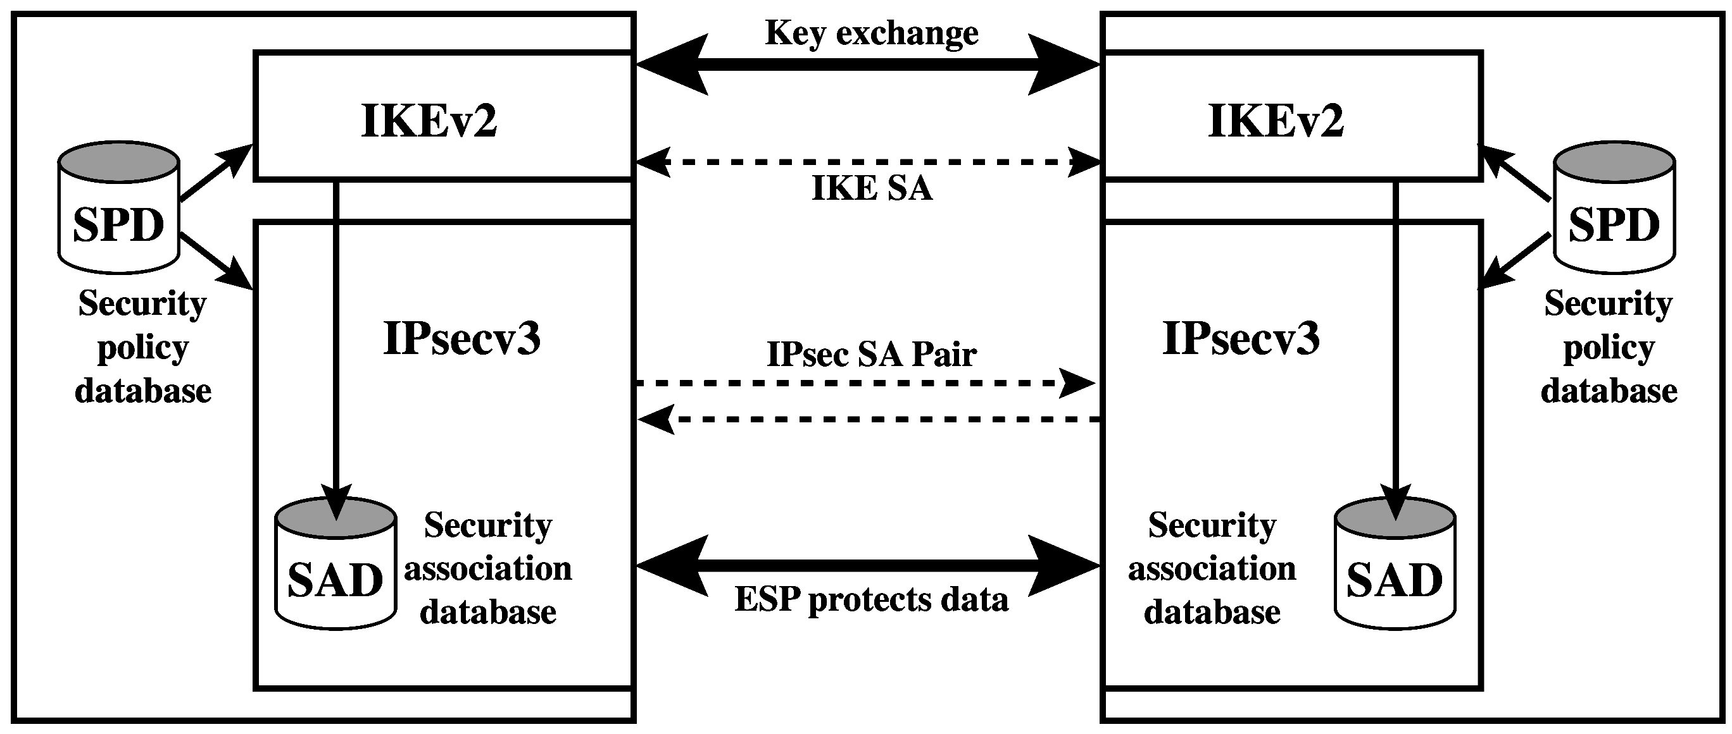
IPsec Architecture
Notes:
Fundamental to the operation of IPsec is the concept of a security policy applied
to each IP packet that transits from a source to a destination. IPsec policy is determined
primarily by the interaction of two databases, the security association
database (SAD) and the security policy database (SPD) . This section provides an
overview of these two databases and then summarizes their use during IPsec operation.
Figure 9.2 illustrates the relevant relationships.

Slide 15
Security Association (SA)
Uniquely identified by three parameters:
One-way logical connection between sender and receiver that affords security services to traffic carried on it
In any IP packet, the SA is uniquely identified by the Destination Address in the IPv4 or IPv6 header, the SPI and the enclosed extension header (AH or ESP)
Security Parameters Index (SPI)
A 32-bit unsigned integer assigned to this SA with local significance only
IP Destination Address
Address of destination endpoint of SA, which can be an end-user system or a network system, e.g., firewall or router
Security protocol identifier
Indicates whether the association is an AH or ESP security association
Notes:
A key concept that appears in both the authentication and confidentiality mechanisms
for IP is the security association (SA). An association is a one-way logical
connection between a sender and a receiver that affords security services to the traffic
carried on it. If a peer relationship is needed for two-way secure exchange, then
two security associations are required.
A security association is uniquely identified by three parameters.
• Security Parameters Index (SPI): A 32-bit unsigned integer assigned to this
SA and having local significance only. The SPI is carried in AH and ESP headers
to enable the receiving system to select the SA under which a received
packet will be processed.
• IP Destination Address: This is the address of the destination endpoint of the
SA, which may be an end-user system or a network system such as a firewall
or router.
• Security Protocol Identifier: This field from the outer IP header indicates
whether the association is an AH or ESP security association.
Hence, in any IP packet, the security association is uniquely identified by the
Destination Address in the IPv4 or IPv6 header and the SPI in the enclosed extension
header (AH or ESP).

Slide 16
Security Association Database (SAD)
Defines the parameters associated with each SA
Normally defined by the following parameters in a SAD entry:
Security parameter index
Sequence number counter
Sequence counter overflow
Anti-replay window
AH information
ESP information
Lifetime of this security association
IPsec protocol mode
Path MTU
Notes:
In each IPsec implementation, there is a nominal Security Association Database
that defines the parameters associated with each SA. A security association is normally
defined by the following parameters in an SAD entry.
• Security Parameter Index: A 32-bit value selected by the receiving end of an
SA to uniquely identify the SA. In an SAD entry for an outbound SA, the SPI
is used to construct the packet’s AH or ESP header. In an SAD entry for an
inbound SA, the SPI is used to map traffic to the appropriate SA.
• Sequence Number Counter: A 32-bit value used to generate the Sequence
Number field in AH or ESP headers, described in Section 20.3 (required for
all implementations).
• Sequence Counter Overflow: A flag indicating whether overflow of the
Sequence Number Counter should generate an auditable event and prevent
further transmission of packets on this SA (required for all implementations).
• Anti-Replay Window: Used to determine whether an inbound AH or ESP
packet is a replay, described in Section 20.3 (required for all implementations).
• AH Information: Authentication algorithm, keys, key lifetimes, and related
parameters being used with AH (required for AH implementations).
• ESP Information: Encryption and authentication algorithm, keys, initialization
values, key lifetimes, and related parameters being used with ESP
(required for ESP implementations).
• Lifetime of this Security Association: A time interval or byte count after
which an SA must be replaced with a new SA (and new SPI) or terminated,
plus an indication of which of these actions should occur (required for all
implementations).
• IPsec Protocol Mode: Tunnel, transport, or wildcard.
• Path MTU: Any observed path maximum transmission unit (maximum size of
a packet that can be transmitted without fragmentation) and aging variables
(required for all implementations).
The key management mechanism that is used to distribute keys is coupled to
the authentication and privacy mechanisms only by way of the Security Parameters
Index (SPI). Hence, authentication and privacy have been specified independent of
any specific key management mechanism.
IPsec provides the user with considerable flexibility in the way in which IPsec
services are applied to IP traffic. As we will see later, SAs can be combined in a
number of ways to yield the desired user configuration. Furthermore, IPsec provides
a high degree of granularity in discriminating between traffic that is afforded
IPsec protection and traffic that is allowed to bypass IPsec, as in the former case
relating IP traffic to specific SAs.

Slide 17
Security Policy Database (SPD)
The means by which IP traffic is related to specific SAs
Contains entries, each of which defines a subset of IP traffic and points to an SA for that traffic
In more complex environments, may be multiple entries that potentially relate to a one or more SAs associated with a single SPD entry
Each SPD entry is defined by a set of IP and upper-layer protocol field values called selectors
These are used to filter outgoing traffic in order to map it into a particular SA
Notes:
The means by which IP traffic is related to specific SAs (or no SA in the case of
traffic allowed to bypass IPsec) is the nominal Security Policy Database (SPD). In
its simplest form, an SPD contains entries, each of which defines a subset of IP traffic
and points to an SA for that traffic. In more complex environments, there may
be multiple entries that potentially relate to a single SA or multiple SAs associated
with a single SPD entry. The reader is referred to the relevant IPsec documents for
a full discussion.
Each SPD entry is defined by a set of IP and upper-layer protocol field values,
called selectors . In effect, these selectors are used to filter outgoing traffic in order
to map it into a particular SA. Outbound processing obeys the following general
sequence for each IP packet.
1. Compare the values of the appropriate fields in the packet (the selector fields)
against the SPD to find a matching SPD entry, which will point to zero or
more SAs.
2. Determine the SA if any for this packet and its associated SPI.
Do the required IPsec processing (i.e., AH or ESP processing).

Slide 18
SPD Entries
The following selectors determine an SPD entry:
Remote IP address
This may be a single IP address, an enumerated list or range of addresses, or a wildcard (mask) address
Latter two required to support more than one destination system sharing the same SA
Local IP address
This may be a single IP address, an enumerated list or range of addresses, or a wildcard (mask) address
Latter two required to support more than one source system sharing the same SA
Next layer protocol
The IP protocol header includes a field that designates the protocol operating over IP
Name
A user identifier from the operating system
Not a field in the IP or upper-layer headers but is available if IPsec is running on the same operating system as the user
Local and remote ports
These may be individual TCP or UDP port values, an enumerated list of ports, or a wildcard port
Notes:
The following selectors determine an SPD entry:
• Remote IP Address: This may be a single IP address, an enumerated list or
range of addresses, or a wildcard (mask) address. The latter two are required
to support more than one destination system sharing the same SA (e.g., behind
a firewall).
• Local IP Address: This may be a single IP address, an enumerated list or range
of addresses, or a wildcard (mask) address. The latter two are required to support
more than one source system sharing the same SA (e.g., behind a firewall).
• Next Layer Protocol: The IP protocol header (IPv4, IPv6, or IPv6 Extension)
includes a field (Protocol for IPv4, Next Header for IPv6 or IPv6 Extension)
that designates the protocol operating over IP. This is an individual protocol
number, ANY, or for IPv6 only, OPAQUE. If AH or ESP is used, then this IP
protocol header immediately precedes the AH or ESP header in the packet.
• Name: A user identifier from the operating system. This is not a field in the IP
or upper-layer headers but is available if IPsec is running on the same operating
system as the user.
• Local and Remote Ports: These may be individual TCP or UDP port values,
an enumerated list of ports, or a wildcard port.

Slide 19
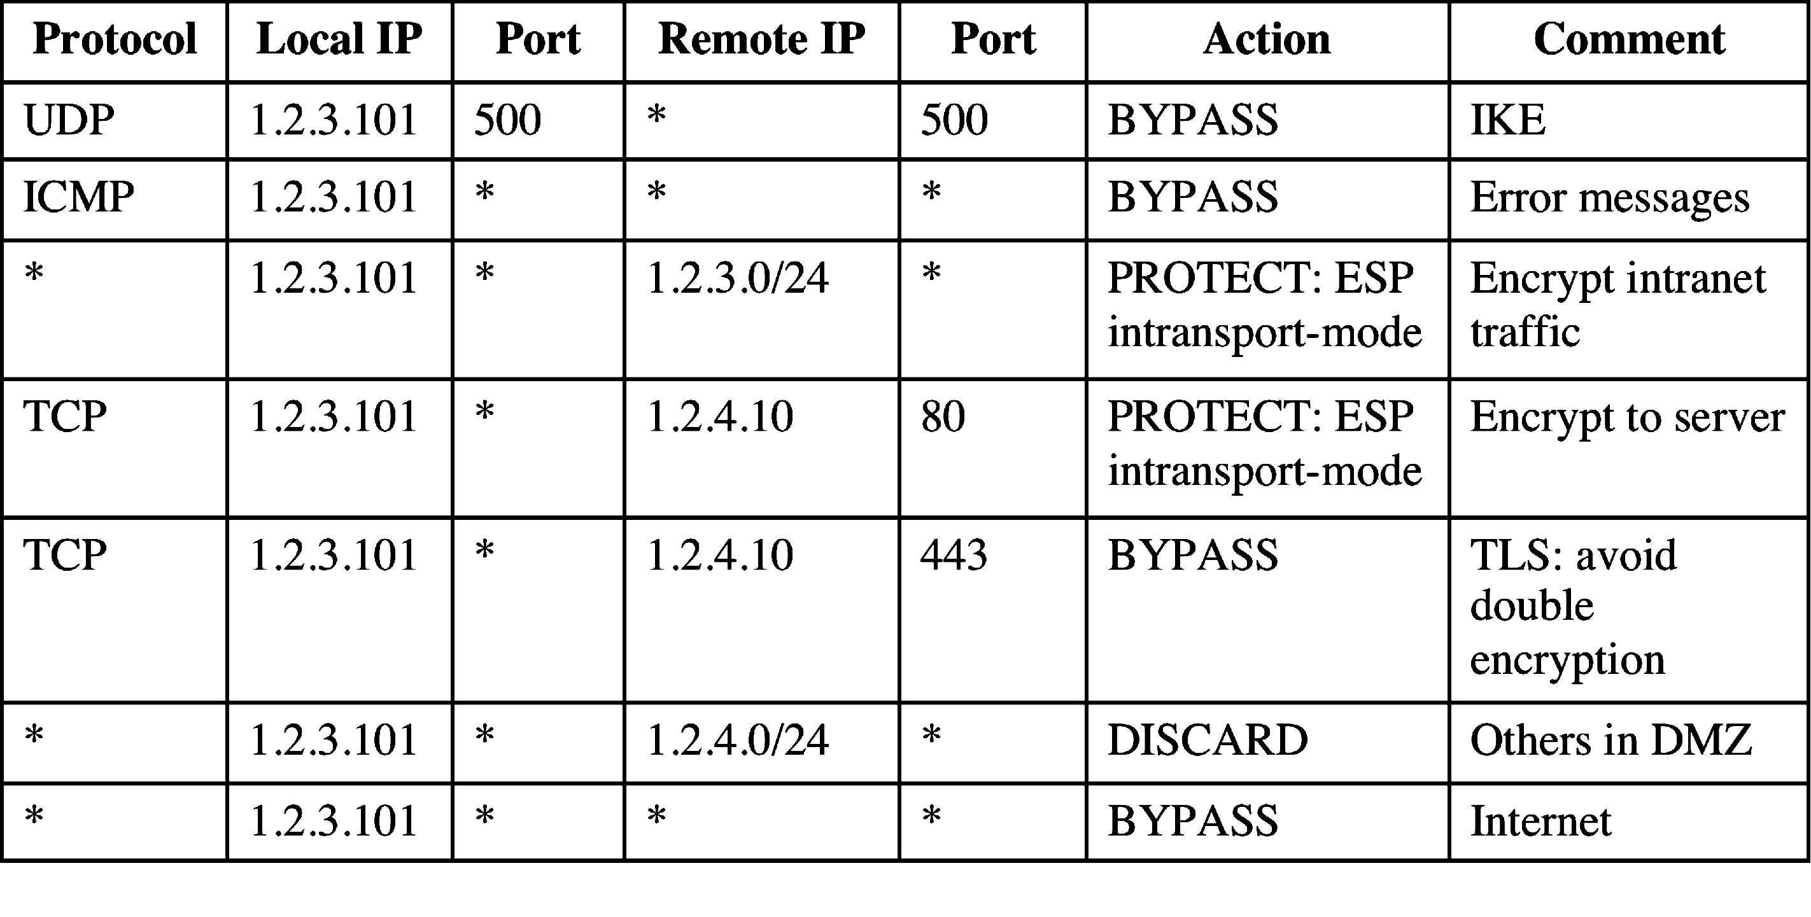
Host SPD Example
Notes:
Table 9.2 provides an example of an SPD on a host system (as opposed to
a network system such as a firewall or router). This table reflects the following
configuration: A local network configuration consists of two networks. The
basic corporate network configuration has the IP network number 1.2.3.0/24.
The local configuration also includes a secure LAN, often known as a DMZ,
that is identified as 1.2.4.0/24. The DMZ is protected from both the outside
world and the rest of the corporate LAN by firewalls. The host in this example
has the IP address 1.2.3.10, and it is authorized to connect to the server 1.2.4.10
in the DMZ.
The entries in the SPD should be self-explanatory. For example, UDP port
500 is the designated port for IKE. Any traffic from the local host to a remote host
for purposes of an IKE exchange bypasses the IPsec processing.

